Slide 1
Nuvoton Quad-Copter Solution

Slide 2
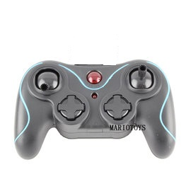
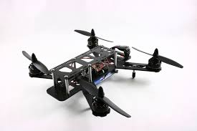
Nuvoton Fly Control System
Nuvoton
M452
Nuvoton
N79E814
SSV 2.4G RF

Slide 3
Nuvoton Fly Control System
ESC0
ESC1
ESC2
ESC3
SSV 2.4GRF
PWM
M4
SPI
51
SSV 2.4GRF
ADC
SPI
I2C
ACC
GYRO
MAG
BARO
Stick/Button

Slide 4
Nuvoton Fly Control System
Nuvoton 32 bit cortex-M4 mcu.
Support High-Speed ESC(400Hz).
Support Quad-X 250mm frame.
Support SSV 2.4G RF Receiver .
Support Low battery detect.
Support Low R.C signal detect.
Support on-chip flash(calibration parameters).
Support In-Fly PID update.

Slide 5
2.4G RC Transceiver System
Nuvoton N79E814 .(51 based)
SSV 2.4G RF.
0 dBm. (1mW)
250K bps data rate.
Support USA control mode(mode 2/3)
8 buttons for channel trim.
Parameter on-chip flash saving.
2 buttons for mode switch
~100M distance in open field.

Slide 6
RC Controls
Support 6 Channel
  THRO (THRO)
  AILE (ROLL)
  ELEV (PITCH)
  RUDD (YAW)
  GEAR (Alt-Hold)
  AUX1 (Stabilize/Mag/Headfree)
SSV 2.4G Bi-direction RF
  Auto frequency switch
  Low battery warning
  Low RSSI warning

Slide 7
Stabilization System
10 DOF Sensor Fusion.
Quaternion based AHRS algorithms.
Support 2 level PID control.
Support Sensor Calibration.
More than 400Hz AHRS Refresh Rate.
Sensor Calibration
Gyroscope drift cancellation.

Slide 8
Stabilization System
ESC 1~4
B.T. module
UART
PWM
Motor Driver
Parameters
SPI
SSV RC
PID Control
RC Driver
Stabilizer
Sensor Driver
I2C
Sensors
Euler Angle
Sensor Data
Application Interface
Nuvoton AHRS Core
Sensor Calibration
10 DOF Sensor Fusion
Quaternion
400Hz

Slide 9
Fly Modes
Stabilize mode
  ACC + GYRO
Mag mode
  ACC+GYRO+MAG
Head-Free mode
  Mag mode based
  Reference current head as front.
Altitude hold mode
  Keep copter altitude by barometer.

Slide 10
Sensor Supports
ACC/GYRO
  MPU6050
MAG
  HMC5883L
  AK8975
BARO
  MS5611
  BMP085

Slide 11
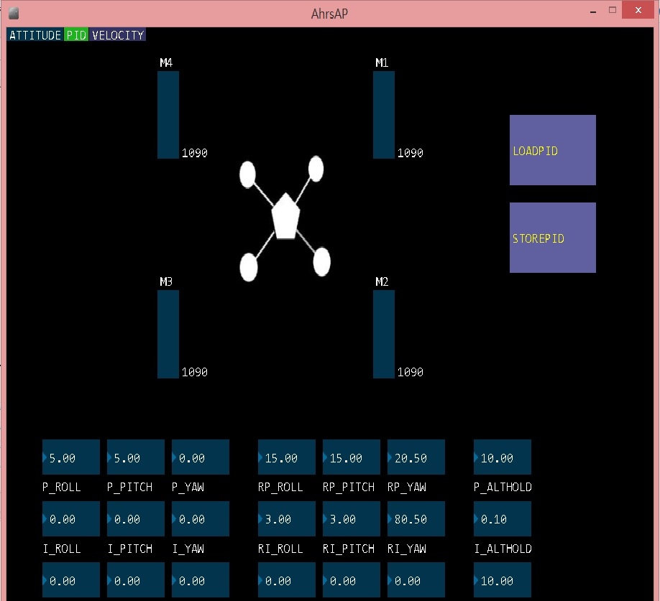
PID Control Tools

Slide 12
PID Control Tool
2 Level PID Control
  Level PID
    Roll
    Pitch
    Yaw
  Rate PID
    Roll
    Pitch
    Yaw
Altitude Hold PID Control

Slide 13
Sensor Calibration
ACC Calibration
  Fast Z Calibration
  Full Calibration (6 face cubic)
  1 degree precision
Mag Calibration
  3 Axis full rotation
  Soft-Iron and Hard-Iron cancelation
  1.5 degree precision
Gyro Calibration
  Gyro center calibration (drift cancel)
  Gyro Scale calibration.
  2 degree/hour precision

Slide 14
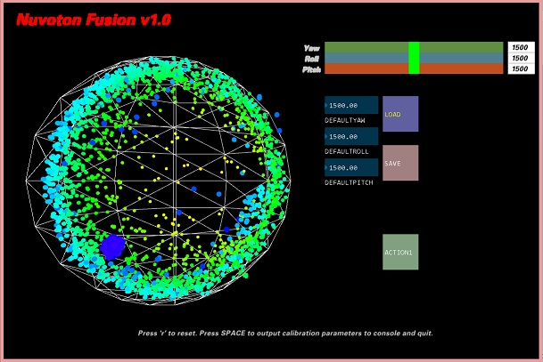
Calibration Tools

Slide 15
Calibration Tools
ACC Calibration
  Fast mode (sample Z face only)
  Full mode (Sample all 6 faces)
Mag Calibration
  User Free Rotation
  Sample points display
  Calibration quality indicator

